Slide 1
SQL Server Concurrency and Transactions
Module 4

Slide 2
Learning Units covered in this Module
Lesson 1: SQL Server Transactions
Lesson 2: SQL Server Isolation Levels
Lesson 3: SQL Server Locking
Lesson 4: Troubleshooting Concurrency Performance

Slide 3

Objectives
After completing this learning, you will be able to:
Understand what is a transaction and its types.
Recommendations for using transactions.
Monitor current transactions in SQL Server.
Describe the concurrency and concurrency types.
Blocking and Deadlocking

Slide 4
Lesson 1: SQL Server Concurrency and Transactions

Slide 5
What is a Transaction?
A transaction is a sequence of steps that perform a logical unit of work.
Must Exhibit ACID properties, to qualify as a transaction.
A - Atomicity
A transaction is either fully completed or not at all.
C - Consistency
A transaction must leave data in a consistent state.
I - Isolation
Changes made by a transaction must be isolated from other concurrent transactions.
D - Durability
The modifications persist even in the event of a system failure.
Notes:
A transaction is a sequence of steps that perform a logical unit of work. They must exhibit four properties that are collectively known as ACID. Transactions ensure that multiple data modifications are processed as a unit. For example, a banking transaction might credit one account and debit another. Both steps must be completed together or not at all. SQL Server supports transaction processing to manage multiple transactions.
Atomicity
Atomicity means that either all the steps in the transaction must succeed or none of them must be performed. For example, when money is transferred between two bank accounts, both the debit and credit actions must be performed or none should be performed.
Consistency
Consistency ensures that when the transaction is complete, data must be in a consistent state. A consistent state is one where the data conforms to the business rules related to the data. Inconsistent data violates one or more business rules. In SQL Server, the database has to be in a consistent state after each statement within a transaction and not only at the end of the transaction.
Isolation
Isolation defines that changes made by a transaction must be isolated from other concurrent transactions.
Durability
Durability defines that when the transaction is complete, the changes must be made permanent in the database and must survive even system failures.
References:
For more information on Transactions (Database Engine), refer:
https://docs.microsoft.com/en-us/previous-versions/sql/sql-server-2008-r2/ms190612(v=sql.105)
For more information on Transaction Fundamentals, refer:
https://docs.microsoft.com/en-us/previous-versions/z80z94hz(v=vs.90)
For more information on Write-Ahead Transaction Log, refer:
https://docs.microsoft.com/en-us/previous-versions/sql/sql-server-2008-r2/ms186259(v=sql.105)

Slide 6
Transaction Modes
Auto-Commit
Explicit
Implicit
Individual statements that complete successfully, will be committed. If errors are encountered the statement is rolled back.
Transaction is explicitly defined with a BEGIN TRANSACTION and COMMIT TRANSACTION statement.
Transaction starts automatically once first statement of a batch is received. Must still manually COMMIT or ROLLBACK transaction.

Slide 7
Auto-Commit transaction Mode
Default transaction management mode of the SQL Server Database Engine
Each statement is either committed or rolled back automatically upon completion.
A syntax error will result in a batch terminating error.
A run-time error will result in a statement terminating error.
Database engine operates in autocommit until started an explicit transaction
XACT_ABORT ON converts statement into batch terminating errors
Compilation errors not affected by XACT_ABORT ON
This might allow part of the batch to commit.
This will stop the entire batch from being executed.
Notes:
Key Points:
The Autocommit mode is the default transaction management mode of the SQL Server Database Engine. Every Transact-SQL (T-SQL) statement is committed or rolled back when it completes. If a statement completes successfully, it is committed and if it encounters any error, it is rolled back.
The Autocommit mode:
A connection to an instance of the database engine operates in the Autocommit mode whenever this default mode has not been overridden by either explicit or implicit transactions. The Autocommit mode is also the default mode for ActiveX data Objects (ADO), .NET Framework Data Provider, Open Database Connectivity (ODBC) , and DB-Library.
A connection to an instance of the Database Engine operates in the Autocommit mode until a BEGIN TRANSACTION statement starts an explicit transaction, or implicit transaction mode is set on. When the explicit transaction is committed or rolled back, or when implicit transaction mode is turned off, the connection returns to the Autocommit mode.
When SET XACT_ABORT is ON, if a Transact-SQL statement raises a run-time error, the entire transaction is terminated and rolled back.
When SET XACT_ABORT is OFF, in some cases only the Transact-SQL statement that raised the error is rolled back and the transaction continues processing.
Depending upon the severity of the error, the entire transaction may be rolled back even when SET XACT_ABORT is OFF. OFF is the default setting in a T-SQL statement, while ON is the default setting in a trigger.
Compile errors, such as syntax errors, are not affected by SET XACT_ABORT.
Compile Errors
Compile errors (such as syntax errors) are not affected by SET XACT_ABORT. When working in the Autocommit mode, compile time errors can cause more than one T-SQL statement to fail. In this mode, a batch of statements is compiled as a unit and if a compile error is found, nothing in the batch is compiled or executed.
Example :
CREATE TABLE NewTable (Id INT PRIMARY KEY, Info CHAR(3));
GO
INSERT INTO NewTable VALUES (1, 'aaa');
INSERT INTO NewTable VALUES (2, 'bbb');
INSERT INTO NewTable VALUSE (3, 'ccc'); -- Syntax error.
GO
SELECT * FROM NewTable; -- Returns no rows.
GO
References :https://docs.microsoft.com/en-us/sql/odbc/reference/develop-app/auto-commit-mode?view=sql-server-ver15

Slide 8


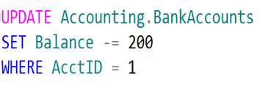
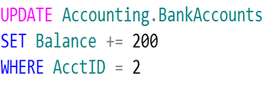
Logical Units of Work – Auto Commit Transactions
$200
Jack
Diane
Transaction 1
Transaction 2

Slide 9
Explicit transaction mode
An explicit transaction is one in which you explicitly define both the start and end of the transaction.
Begins with the BEGIN TRANSACTION statement
Transaction can be started with a mark
Can have one or more statements
Need to explicitly commit or rollback the transaction
using COMMIT TRANSACTION or ROLLBACK TRANSACTION
Can also use
SAVE TRANSACTION <savepoint_name>– to rollback a transaction to named Point
BEGIN TRANSACTION <transaction_name>WITH MARK [ 'description’ ] – to specify transaction marked in log
Notes:
An explicit transaction is one in which you explicitly define both the start and end of the transaction. You can use explicit transactions to define your own units of business logic. For example, in a bank transfer function, you might enclose the withdrawal of funds from one account and the deposit of those funds in another account within one logical unit of work. DB-Library applications and Transact-SQL scripts use the BEGIN TRANSACTION, COMMIT TRANSACTION, COMMIT WORK, ROLLBACK TRANSACTION, or ROLLBACK WORK Transact-SQL statements to define explicit transactions.
Starting a Transaction:
You start a transaction by using the BEGIN TRANSACTION statement. You can specify a name for the transaction and use the WITH MARK option to specify a description for the transaction to be marked in the transaction log. This transaction log mark can be used by database administrators when restoring a database to indicate the point to which you want to restore. The BEGIN TRANSACTION statement is often abbreviated to BEGIN TRAN.
XACT_ABORT has an effect on explicit transaction as well as on implicit transactions.
By default, only the statement in error would be rolled back and the batch would continue to run and commit the other statements in the transaction.
Therefore error handling must be implemented (will be discussed in a later module) or XACT_ABORT can be turned ON to abort the batch and rollback the whole transaction in case of an error.
Committing a Transaction:
You can commit the work contained in a transaction by issuing the COMMIT TRANSACTION statement. Use this to end a transaction if no errors have occurred and you want the contents of the transaction to be committed to the database.
The COMMIT TRANSACTION statement is often abbreviated to “COMMIT”. To assist users from other database platforms that are migrating to SQL Server, the statement COMMIT WORK can also be used.
Rolling Back a Transaction:
You can cancel the work contained in a transaction by issuing the ROLLBACK TRANSACTION statement.Use this to end a transaction if errors have occurred and you want the changes made by the transaction to be undone and the database to return to the state it was before the transaction began.
A rollback on an inner transaction also rolls back any outer transactions and a rollback on the outermost transaction will undo any inner committed transaction.
Saving a Transaction:
By using savepoints, you can roll back a transaction to a named point in the transaction, instead of the beginning of the transaction. Inside the body of a transaction, create a savepoint by issuing the SAVE TRANSACTION statement and specifying the name of the savepoint. You can then use the ROLLBACK TRANSACTION statement and specify the savepoint name to roll the changes back to that point.
Use savepoints when an error is unlikely to occur and the cost of checking the data before the error occurs is much higher than testing for the error after the data modifications have been submitted.
Marked Transactions
The WITH MARK option causes the transaction name to be placed in the transaction log. When restoring a database to an earlier state, the marked transaction can be used in place of a date and time

Slide 10
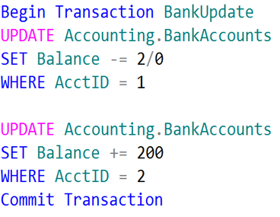
Single Logical Unit of Work – Explicit Transactions
Jack
Diane
Transaction 1
$200

Slide 11
Implicit transaction mode
Equivalent to an unseen BEGIN TRANSACTION being executed
Transaction starts automatically once first statement of a batch is received
SET IMPLICIT_TRANSACTIONS ON used at statement level
Enabled at Server level by using sp_configure 'user options’ , 2
It can be symptom of severe blocking issues on the server
Must use commit after SELECTs or DML, otherwise transaction remains open
Notes:
Key Point:
When ON, the system is in implicit transaction mode. This means that if @@TRANCOUNT = 0, any of the following Transact-SQL statements begins a new transaction. It is equivalent to an unseen BEGIN TRANSACTION being executed
IMPLICIT_TRANSACTIONS ON is not popular. In most cases where IMPLICIT_TRANSACTIONS is ON, it is because the choice of SET ANSI_DEFAULTS ON has been made.
It leaves transaction open in SQL server until Commit/rollback is not used.
Recommendations : Don’t use Implicit transaction until required , Also if SET ANSI_DEFAULTS ON used in code then set it off at end otherwise it will leave IMPLICIT TRANSACTION ON
===============
More Information
===============
The Implicit transaction mode:
SQL Server can automatically or, more precisely, implicitly starts a transaction for you if the SET IMPLICIT_TRANSACTIONS ON statement is run, or if the implicit transaction option is turned ON globally by running sp_configure user options 2. (The bit mask 0x2 must be turned ON for the user option, so you might have to perform an OR operation with the existing user option value.
When a connection is operating in implicit transaction mode, the database engine automatically starts a new transaction after the current transaction is committed or rolled back. You do nothing to delineate the start of a transaction; you only commit or roll back each transaction. Implicit transaction mode generates a continuous chain of transactions.
After implicit transaction mode has been set on for a connection, the instance of the Database Engine automatically starts a transaction when it first executes any of these statements.
In most cases, it is best to work in Autocommit mode and define transactions explicitly using the BEGIN TRANSACTION statement. However for applications that were originally developed on systems other than SQL Server, the implicit transaction mode can be useful.
Implicit transaction mode automatically starts a transaction when you issue certain statements and the transaction then continues until you issue a commit statement or a rollback statement.
Example : SET IMPLICIT_TRANSACTIONS ON;
--Session 1
SET IMPLICIT_TRANSACTIONS ON;
GO
UPDATE [Demo].[DemoSalesOrderDetailSeed]
SET [SpecialOfferID] = 0
WHERE OrderID= 55;
GO
--Session 2 –it will show transaction of session 1 is still open
select * from Sys.sysprocesses where open_tran=1
References:
For more information on SET IMPLICIT_TRANSACTIONS Transact-SQL), refer:
https://docs.microsoft.com/en-us/sql/t-sql/statements/set-implicit-transactions-transact-sql?redirectedfrom=MSDN&view=sql-server-ver15

Slide 12
Considerations for using transactions
Keep transactions as short as possible
Do not require user input
Do not open a transaction while browsing through data
Access the least amount of data possible
Do not open the transaction before it is required
Ensure that appropriate indexing is in place
Try to access resources in the same order
Wherever possible access resources in the same order to avoid Deadlocks
Notes:
There are many general considerations that need to be kept in mind when working with transactions.
Keep transactions as short as possible.
Transactions must be as short as possible. Longer transactions increase the likelihood that users will not be able to access locked data. Some methods to keep transactions short include the following:
Do not require input from users during a transaction. Address issues that require user interaction before you start the transaction. For example, if you are updating a customer record, obtain the necessary information from the user before you begin the transaction. A golden rule here is to never hold a transaction across a user interaction.
Do not open a transaction while browsing through data, if at all possible. Transactions must not start until all preliminary data analysis has been completed.
INSERT, UPDATE, and DELETE must be the primary statements in a transaction and they must be written to affect the fewest number of rows. A transaction must never be smaller than a logical unit of work.
Access the least amount of data possible while in a transaction. This decreases the number of locked rows and reduces contention.
Ensure that appropriate indexing is in place as this reduces the number of pages that need to be accessed and locked.
Try to access resources in the same order.
Accessing resources in the same order within transactions tends to naturally serialize your access to the database and can help to avoid deadlocks. However, doing this is not always possible.
Note: Deadlocks will be discussed later in the module.

Slide 13

Demonstration
Using IMPLICIT TRANSACTIONS and its impact on server
Notes:
M04L01Demo01
Consider demoing the following: E:\Demos\M04L01Demo01\Implicit_Transaction.sql
For this Demo you need to open the two Session in SSMS
Session 1 , For running select and update statement with Implicit transaction on
Second Session to show that Transaction started in session 1 is still open in SQL server so need to commit/rollback the transaction started in session1 then there will not be any open transaction
In case of Update: when you run the update statement in Session 1, run the query to show open transaction in Session 2 and thereafter just run the select statement against table where update is happening and show the users that it is not returning any resulting but also not finished. Once you finish the session 1 statement using rollback/commit , session 2 will show select stamen result also there will not be any open transaction in SQL.
This can be a severe performance impact in OLTP environment.

Slide 14
Knowledge Check
What is the default transaction mode in SQL Server?
What will the transaction count be after the following code is executed?
BEGIN TRANSACTION
BEGIN TRANSACTION
ROLLBACK TRANSACTION
Notes:
Q1: What is the default transaction mode in SQL Server?
A1: Autocommit
Q2: What will the transaction count be after the following code is executed
BEGIN TRANSACTION
BEGIN TRANSACTION
ROLLBACK TRANSACTION
A2: 0
Q3: What are two different concurrency models supported by SQL server ?
A3: Pessimistic and Optimistic

Slide 15
Lesson 2: SQL Server Isolation Levels

Slide 16
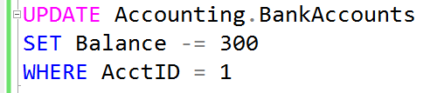


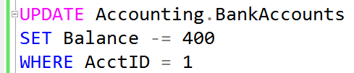
What is a Lock?
Transaction 1
Transaction 2

Slide 17
Types of concurrency problems
Following are common concurrency problems in SQL Server
Dirty Read
The values retrieved may reflect uncommitted changes that could be rolled back.
Non-Repeatable Read
Data may change between two reads.
If you execute a SELECT twice within a single transaction, the values returned may differ as other processes could have modify data between SELECTs.
Phantom Read
If a range query is repeated within a single transaction, it may return additional rows not present in the first results.
It’s still possible that another session can insert rows that belongs to the range of the initial select.
Lost Update:
Problem occurs when there are two transactions are unaware of each other.
Later transaction overwrites the earlier update..
Notes:
Key Points:
Dirty Read: Other users can see uncommitted data.
Lost Update: Problem occurs when there are two transactions are unaware of each other. Later transaction overwrites the earlier update..
Non-Repeatable Read: Update made by another session can be seen by transaction which are not completed yet.
Phantom Read: Insert made by another session can be seen by session whose transaction is not completed yet.

Slide 18
ANSI SQL Isolation Levels
Isolation is a trade-off between correctness and concurrency.
Isolation Level | Locking Duration and Range | Dirty Read | Lost Update | Non-Repeatable Read | Phantom
READ UNCOMMITTED | No locks are taken, so locks taken by other processes aren’t blocking. | Yes | Yes | Yes | Yes
READ COMMITTED (Default) | Shared locks are taken on resources being read. They are held only for the duration of the read. | No | Yes | Yes | Yes
REPEATABLE READ | Shared locks are taken on resources being read. They are held for the duration of the transaction. | No | No | No | Yes
SERIALIZABLE | Shared range locks are taken on resources being read and adjacent resources. They are held for the duration of the transaction. | No | No | No | No
Notes:
Key Points:
An isolation level defines the degree to which one transaction must be isolated from resource or data modifications made by other transactions.
By default, SQL Server operates at an isolation level of READ COMMITTED.
===============
More Information
===============
Isolation levels are described in terms of which concurrency side-effects, such as dirty reads or phantom reads, are allowed.
To make use of either more or less-strict isolation levels in applications, you can customize locking for an entire session by setting the isolation level of the session with the SET TRANSACTION ISOLATION LEVEL statement.
SNAPSHOT isolation is not an ANSI standard isolation level, it is an isolation level introduced in SQL Server 2005 to provide serializable-like consistency without the same concurrency issues. SNAPSHOT isolation makes use of the row-version store in tempdb to create a copy of a row undergoing modification. In a SNAPSHOT transaction, SQL Server will not acquire Shared locks for reading data, it will read the row-version instead. Because of the added overhead of maintaining the row-version store for all data modifications, SNAPSHOT isolation is not on by default and must be enabled in the database(s) where it will be used.
References:
For more information on Isolation Levels in the Database Engine, refer: https://docs.microsoft.com/en-us/previous-versions/sql/sql-server-2008-r2/ms189122(v=sql.105)?redirectedfrom=MSDN
For more information on Understanding Row Versioning-Based Isolation Levels, refer: https://docs.microsoft.com/en-us/previous-versions/sql/sql-server-2008-r2/ms189050(v=sql.105)?redirectedfrom=MSDN

Slide 19
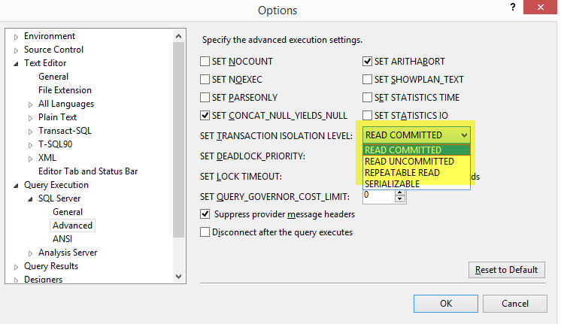
Transaction Isolation Levels
Isolation Levels

Slide 20


Lost Updates
--SQL Server Concurrency
-- Lost Update - Session 1
DECLARE @OldBalance int, @NewBalance int
BEGIN TRAN
SELECT @OldBalance = Balance
FROM Accounting.BankAccounts
WHERE AcctID = 1
SET @NewBalance = @OldBalance - 300
WAITFOR DELAY '00:00:10:000’
UPDATE Accounting.BankAccounts
SET Balance = @NewBalance
WHERE AcctID = 1
SELECT @OldBalance AS OldBalance,
AcctID, AcctName, Balance
FROM Accounting.BankAccounts
WHERE AcctID = 1
COMMIT TRAN
--SQL Server Concurrency
-- Lost Update - Session 2
DECLARE @OldBalance int, @NewBalance int
BEGIN TRAN
SELECT @OldBalance = Balance
FROM Accounting.BankAccounts
WHERE AcctID = 1
SET @NewBalance = @OldBalance - 400
UPDATE Accounting.BankAccounts
SET Balance = @NewBalance
WHERE AcctID = 1
SELECT @OldBalance AS OldBalance,
AcctID, AcctName, Balance
FROM Accounting.BankAccounts
WHERE AcctID = 1
COMMIT TRAN

Slide 21


Uncommitted dependency (dirty read)
--SQL Server Concurrency
-- Dirty Read - Session 1
SET TRANSACTION ISOLATION LEVEL
READ UNCOMMITTED
BEGIN TRAN
UPDATE Accounting.BankAccounts
SET Balance -= 300
WHERE AcctID = 1
WAITFOR DELAY '00:00:10:000'
ROLLBACK TRAN
SELECT AcctID, AcctName, Balance
FROM Accounting.BankAccounts
WHERE AcctID = 1
Clean Read
--SQL Server Concurrency
--Dirty Read - Session 2
SET TRANSACTION ISOLATION LEVEL
READ UNCOMMITTED
SELECT * FROM Accounting.BankAccounts
WHERE AcctID = 1
Dirty Read

Slide 22
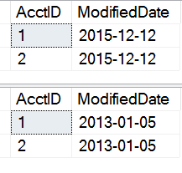
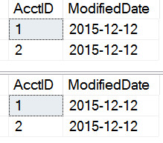
Inconsistent analysis (non-repeatable read)
--SQL Server Concurrency
--Repeatable Read - Session 1
SET TRANSACTION ISOLATION LEVEL
READ COMMITTED -- Before Example
--REPEATABLE READ --Switch for Example
BEGIN TRAN
SELECT AcctID, ModifiedDate
FROM Accounting.BankAccounts
WAITFOR DELAY '00:00:10:000'
SELECT AcctID, ModifiedDate
FROM Accounting.BankAccounts
COMMIT TRAN
READ COMMITTED
REPEATABLE READ
--SQL Server Concurrency
--Repeatable Read - Session 2
BEGIN TRAN
UPDATE Accounting.BankAccounts
SET ModifiedDate = ‘20130105
COMMIT TRAN

Slide 23
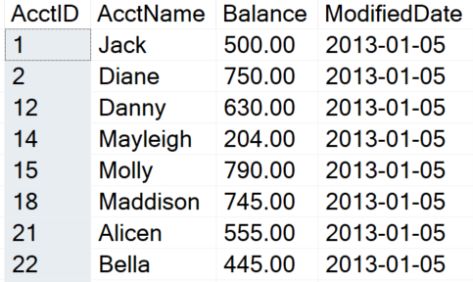
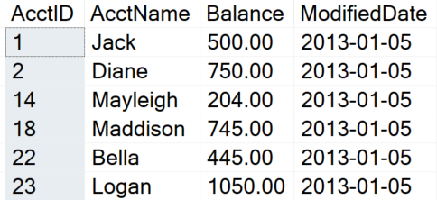
Phantom Reads
--SQL Server Concurrency
--Phantom Read - Session 1
SET TRANSACTION ISOLATION LEVEL
READ COMMITTED
BEGIN TRAN
SELECT AcctID, AcctName,
Balance, ModifiedDate
FROM Accounting.BankAccounts
WAITFOR DELAY '00:00:10:000'
SELECT AcctID, AcctName,
Balance, ModifiedDate
FROM Accounting.BankAccounts
COMMIT TRAN
--SQL Server Concurrency
--Phantom Read - Session 2
USE TestDB
BEGIN TRAN
DELETE FROM Accounting.BankAccounts
WHERE AcctID IN(12, 15, 21)
COMMIT TRAN
Missing records

Slide 24
Balancing Isolation with concurrency
Transaction Isolation Level determines duration and range of read locks.
Total
Serializable
None
Repeatable Read
Phantom Reads
Isolation
Read Committed
Non-repeatable Reads
Read Uncommitted
None
Dirty Reads
Exclusive data access
Concurrency
Shared data access
Notes:
Concurrency
https://docs.microsoft.com/en-us/previous-versions/sql/compact/sql-server-compact-4.0/ms171845(v=sql.110)

Slide 25
Concurrency
Avoids inconsistency result or abnormal behavior
Support for two concurrency models
Pessimistic concurrency
This is the default concurrency model in SQL Server
Uses locks to avoid concurrency problems
Optimistic concurrency
Uses row versions to support concurrency
Notes:
Key Points: Concurrency is controlled using isolation level
References
https://docs.microsoft.com/en-us/dotnet/framework/data/adonet/transactions-and-concurrency
https://docs.microsoft.com/en-us/dotnet/framework/data/adonet/optimistic-concurrency
https://docs.microsoft.com/en-us/sql/connect/jdbc/understanding-concurrency-control?view=sql-server-ver15

Slide 26
Snapshot Isolation
First Introduced in SQL Server 2005.
Uses Optimistic concurrency.
Managed using Row Versioning.
If ADR is not enabled, row versions are kept in tempdb.
Read Committed Snapshot Isolation (RCSI) | Snapshot Isolation
Can be used with Distributed Transaction | Can’t be used with Distributed Transaction
No code changes required to manage conflicts | Code changes required to manage conflicts
Statement Level Consistency | Transaction-level consistency
Writers still block other writers | Writers don’t block writers, only the first to commit wins, others must rollback/retry
No update conflict | Prone to update conflict
Notes:
Key Points:
Snapshot isolation avoids most locking and blocking by using row versioning.
So, as of SQL Server 2019, if ADR is not enabled, row versions are kept in tempdb as always.
If ADR is enabled, then all row versions, both related to snapshot isolation and ADR, are kept in ADR's Persistent Version Store (PVS), which is located in the user database in a filegroup which the user specifies.
Snapshot isolation prevents readers from blocking writers and vice versa.
===============
More Information
===============
SNAPSHOT isolation is not an ANSI standard isolation level, it is an isolation level introduced in SQL Server 2005 to provide serializable-like consistency without the same concurrency issues. SNAPSHOT isolation makes use of the row-version store in tempdb to create a copy of a row undergoing modification. In a SNAPSHOT transaction, SQL Server will not acquire Shared locks for reading data, it will read the row-version instead. Because of the added overhead of maintaining the row-version store for all data modifications, SNAPSHOT isolation is not on by default and must be enabled in the database(s) where it will be used.
No locks are acquired on the underlying data rows or data pages in a snapshot transaction, which permits other transactions to execute without being blocked by a prior uncompleted transaction.
Transactions that modify data do not block transactions that read data, and transactions that read data do not block transactions that write data, as they normally would under the default READ COMMITTED isolation level in SQL Server. This non-blocking behavior also significantly reduces the likelihood of deadlocks for complex transactions.
Row-versioning is not on by default, you can enable row versioning by using the ALTER DATABASE command.
READ COMMITTED SNAPSHOT guarantees statement-level read consistency it replaces read-committed.
SNAPSHOT ISOLATION LEVEL guarantees transaction-level read consistency.
This means that all read operations in a snapshot transaction view row versions that were committed at the time that the transaction started.
Prior to SQL Server 2019, these versions were stored in tempdb. SQL Server 2019 introduces a new feature, Accelerated Database Recovery (ADR) which requires its own set of row versions.
So, as of SQL Server 2019, if ADR is not enabled, row versions are kept in tempdb as always.
If ADR is enabled, then all row versions, both related to snapshot isolation and ADR, are kept in ADR's Persistent Version Store (PVS), which is located in the user database in a filegroup which the user specifies.
References:
For more information on Understanding Row Versioning-Based Isolation Levels, refer: https://docs.microsoft.com/en-us/previous-versions/sql/sql-server-2008-r2/ms189050(v=sql.105)

Slide 27
Enabling row versioning-based isolation
Read committed snapshot Isolation (RCSI)
READ_COMMITTED_SNAPSHOT database enabled plus READ Committed isolation level
Snapshot Isolation
ALLOW_SNAPSHOT_ISOLATION database enabled plus SNAPSHOT isolation level
Prevents readers from blocking writers
Uses TempDB and avoids placing shared Locks
ALTER DATABASE MyDatabase SET READ_COMMITTED_SNAPSHOT ON
ALTER DATABASE MyDatabase SET ALLOW_SNAPSHOT_ISOLATION ON

Slide 28
Demonstration
Key range locking
Using sys.dm_tran_locks to understand the impact of Locked resources and duration according to Isolation Level
Notes:
M04L02Demo01
Consider demoing the following: E:\Demos\M04L02Demo01\Key_Range_Locking.sql

Slide 29

SQL Server Isolation Levels
Illustrate how snapshot isolation level effect blocking and locking
Notes:
M04L02Lab01
Link to lab: Use electronic material to complete the lab exercise applying a Read-Committed snapshot.

Slide 30
Knowledge Check
What is the default isolation level?
What isolation levels can be set at the database level?
What could be the impact of using the sys.dm_tran_version_store DMV?
Notes:
Read committed
Snapshot isolation and read-committed snapshot
The sys.dm_tran_version_store DMV displays all version records in the version store. Querying this DMV might be inefficient to run because it queries the entire version store, which can be very large if there are a large number of transactions and connections

Slide 31
Lesson 3: SQL Server Locking

Slide 32
Objectives
After completing this learning, you will be able to:
Understand locking concepts.
Understand lock Modes and lock compatibility.
How SQL server choose granularity.
Learn how SQL server escalate locks.
What are lock Hints ?

Slide 33
What is a Lock?
Transaction 1
Transaction 2
TSQL2012.mdf

Slide 34
Multi-Granular Locking
Many items can be locked in SQL Server
Databases
Schema
Objects
Some objects can be locked at different levels of granularity
SQL Server will automatically choose the granularity of the lock based on the estimated cost
Multiple levels of granularity are grouped into a lock hierarchy
Concurrency Cost
Locking Cost
Cost
Row
Page
Table
Notes:
SQL Server locks resources in order to help protect them from concurrent users. Locks can be acquired on many different resources such as:
A database
A database file
An entire table, including all data and indexes
An 8 kilobyte (KB) data page or index page
A row within an index
Metadata information
Internal storage structures, such as heap or B-tree (HoBT) structures
Allocation units
A lock resource defined by an application
Multi-granular locking
To minimize the cost of locking, SQL Server locks resources automatically at a level appropriate to the task. SQL Server has multi-granular locking that allows different types of resources to be locked by a transaction
Locking at a larger granularity, such as tables is expensive in terms of concurrency because locking an entire table restricts access to any part of the table by other transactions but has a lower overhead because fewer locks are being maintained.
Locking at a smaller granularity, such as rows, increases concurrency, but has a higher overhead because more locks must be held if many rows are locked
The Database Engine often needs to acquire locks at multiple levels of granularity to fully help protect a resource. This group of locks at multiple levels of granularity is called a lock hierarchy

Slide 35
Lock Granularity and Hierarchies
Resource | Description
RID | A row identifier used to lock a single row within a heap.
KEY | A row lock within an index used to protect key ranges in serializable transactions.
PAGE | An 8-kilobyte (KB) page in a database, such as data or index pages.
EXTENT | A contiguous group of eight pages, such as data or index pages.
HoBT | A heap or B-tree. A lock protecting heap data pages in a table that does not have a clustered index or the pages of a B-tree index.
TABLE | The entire table, including all data and indexes.
FILE | A database file.
ALLOCATION_UNIT | An allocation unit.
DATABASE | The entire database.

Slide 36
Lock Duration
Mode | Read Committed | Repeatable Read | Serializable | Snapshot
Shared | Held until data read and processed | Held until end of transaction | Held until end of transaction | N/A
Update | Held until data read and processed unless promoted to Exclusive | Held until data read and processed unless promoted to Exclusive | Held until end of transaction unless promoted to Exclusive | Held until data read and processed unless promoted to Exclusive
Exclusive | Held until end of transaction | Held until end of transaction | Held until end of transaction | Held until end of transaction
Notes:
Lock ownership
Most of the locking discussion in this topic relates to the locks owned by transactions. In addition to transactions, cursors and sessions can be owners of locks and they both affect the duration for which locks are held.
When you use the SCROLL_LOCKS option, a cursor lock is held for every row that is fetched until the next row is fetched or the cursor is closed, regardless of the state of a transaction.
Locks owned by session are outside the scope of a transaction. The duration of these locks is bounded by the connection and the process will continue to hold these locks until the process disconnects. A typical lock owned by session is the database (DB) lock. Shared DB lock is not held when the database is in Single user mode.

Slide 37
Lock Mode - Standard
Lock Mode | Description
Schema-Stability (Sch-S) | Used when compiling queries
Schema Modification (Sch-M) | Used when a table data definition language operation (for example, dropping a table) is being performed
Shared (S) | Used for read operations that do not change or update data, such as a SELECT statement
Update (U) | Used on resources that can be updated. Prevents a common form of deadlock that occurs when multiple sessions are reading, locking, and potentially updating resources later
Exclusive (X) | Used for data-modification operations, such as INSERT, UPDATE, or DELETE. Ensures that multiple updates cannot be made to the same resource at the same time
Notes:
The SQL Server Database Engine locks resources by using different lock modes that determine how the resources can be accessed by concurrent transactions. Some locks allow concurrent access to the resource, while others do not. For example, a Shared lock is used to help protect a resource that is being used for read-only access. Since the resource is only going to be read, several concurrent users can have Shared locks on the same resource. If a transaction wants to modify the data, it must first acquire an Exclusive lock. This prevents anyone from reading or writing to the resource, while the transaction is in progress. When an Exclusive lock is in place, no other locks can be granted on the resource.
Lock modes :
Schema modification (Sch-M) locks are taken during a table data definition language (DDL) operation. A Sch-M lock prevents concurrent access to the table. This lock blocks all outside operations until the lock is released. You must use Sch- M locks to prevent access to affected tables by concurrent operations
Schema stability (Sch-S) locks are taken when compiling and running queries. Sch-S locks do not block any transactional locks, including exclusive (X) locks. Transactions continue to run while a query is being compiled
Shared (S) locks allow concurrent transactions to read (SELECT) a resource under pessimistic concurrency control. However, no other transactions can modify the data while shared (S) locks exist on the resource
Update (U) locks prevent a common form of deadlock. Only one transaction can obtain an update (U) lock to a resource at a time. If a transaction modifies a resource, the update (U) lock is converted to an exclusive (X) lock
Exclusive (X) locks prevent access to a resource by concurrent transactions. With an exclusive (X) lock, by default, no other transactions can modify data
Intent shared (IS) lock helps protect requested or acquired shared locks on some resources lower in the hierarchy
Intent exclusive (IX) lock helps protect requested or acquired exclusive locks on some resources lower in the hierarchy. IX is a superset of IS, and it also helps protect requesting shared locks on lower-level resources

Slide 38
Lock Mode - Special
Lock Mode | Description
Intent Shared (IS) | Have or will request shared lock(s) at a finer level
Intent Update (IU) | Have or will request update lock(s) at a finer level
Intent Exclusive (IX) | Have or will request exclusive lock(s) at a finer level
Shared Intent Update (SIU) | Have shared lock with intention to acquire update lock at a finer level
Shared Intent Exclusive (SIX) | Have shared lock with intention to acquire exclusive lock at a finer level
Update Intent Exclusive (UIX) | Have update lock with intention to acquire exclusive lock at a finer level
Bulk Update (BU) | Used when bulk copying data into a table and either TABLOCK hint is specified or the table lock on bulk load table option is set
Notes:
The SQL Server Database Engine locks resources by using different lock modes that determine how the resources can be accessed by concurrent transactions. Some locks allow concurrent access to the resource, while others do not. For example, a Shared lock is used to help protect a resource that is being used for read-only access. Since the resource is only going to be read, several concurrent users can have Shared locks on the same resource. If a transaction wants to modify the data, it must first acquire an Exclusive lock. This prevents anyone from reading or writing to the resource, while the transaction is in progress. When an Exclusive lock is in place, no other locks can be granted on the resource.
Lock modes :
Schema modification (Sch-M) locks are taken during a table data definition language (DDL) operation. A Sch-M lock prevents concurrent access to the table. This lock blocks all outside operations until the lock is released. You must use Sch- M locks to prevent access to affected tables by concurrent operations
Schema stability (Sch-S) locks are taken when compiling and running queries. Sch-S locks do not block any transactional locks, including exclusive (X) locks. Transactions continue to run while a query is being compiled
Shared (S) locks allow concurrent transactions to read (SELECT) a resource under pessimistic concurrency control. However, no other transactions can modify the data while shared (S) locks exist on the resource
Update (U) locks prevent a common form of deadlock. Only one transaction can obtain an update (U) lock to a resource at a time. If a transaction modifies a resource, the update (U) lock is converted to an exclusive (X) lock
Exclusive (X) locks prevent access to a resource by concurrent transactions. With an exclusive (X) lock, by default, no other transactions can modify data
Intent shared (IS) lock helps protect requested or acquired shared locks on some resources lower in the hierarchy
Intent exclusive (IX) lock helps protect requested or acquired exclusive locks on some resources lower in the hierarchy. IX is a superset of IS, and it also helps protect requesting shared locks on lower-level resources

Slide 39
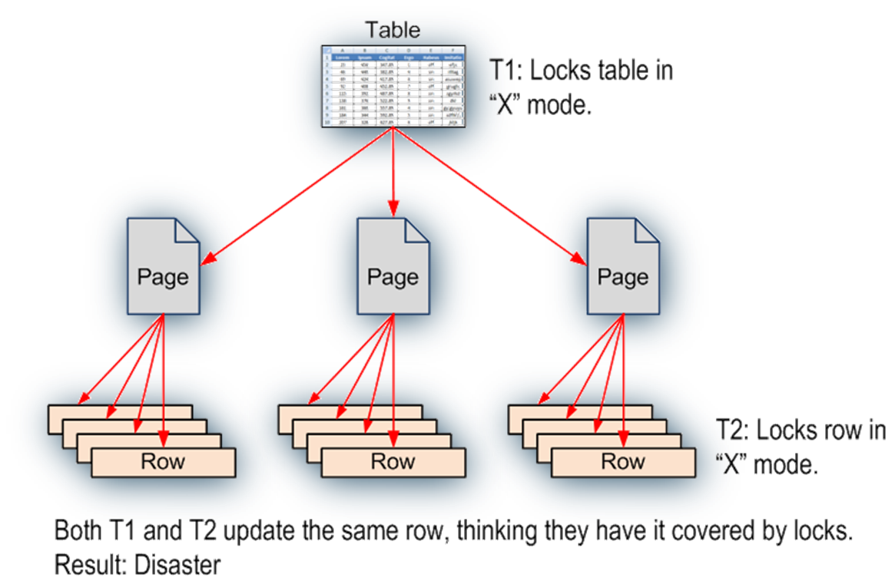
Establish Lock Hierarchy with Intent Locks
To acquire a fine granular lock, you must acquire intent locks on all the higher levels in the hierarchy
Notes:
The example provided in the slide shows, if one transaction (T1) holds an exclusive lock at the table level, and another transaction (T2) holds an exclusive lock at the row level, each of the transactions believe that they have exclusive access to the resource. In this scenario, because T1 believes that it locks the entire table, it might inadvertently make changes to the same row that T2 thought it has locked exclusively. In a multi-granular locking environment, there must be a way to effectively overcome this problem. The solution is intent lock.
An Intent lock is used to establish a lock hierarchy. SQL Server Database Engine acquires low-level locks and also places intent locks on the objects that contain the lower-level objects as follows:
When locking rows or index key ranges, intent lock is acquired on the pages that contain the rows or keys
When locking pages, intent lock is acquired on the higher-level objects that contain the pages. In addition to the intent lock on the object, intent page locks are requested on the following objects:
Leaf-level pages of non-clustered indexes
Data pages of clustered indexes
Heap data pages
An intent lock indicates that SQL Server wants to acquire a shared (S) lock or an exclusive (X) lock on some of the resources lower down in the hierarchy. For example, a shared intent lock placed at the table level means that a transaction intends on placing shared (S) locks on pages or rows within that table. Setting an intent lock at the table level prevents another transaction from subsequently acquiring an exclusive (X) lock on the table containing that page. Intent locks improve performance because SQL Server examines intent locks only at the table level to determine whether a transaction can safely acquire a lock on that table. This removes the requirement to examine every row or page lock on the table to determine whether a transaction can lock the entire table

Slide 40
Lock hierarchy with intent locks
SQL Server uses intent locks to protect parent-level object in the hierarchy by placing an intent shared (IS) or Intent exclusive (IX) lock.
Intent locks are acquired before a lock placed at the lower level.
Intent locks serve two purposes:
Prevent other transactions from modifying parent-level object
Improve the efficiency of the SQL Server Database Engine
Notes:
The example provided in the slide shows, if one transaction (T1) holds an exclusive lock at the table level, and another transaction (T2) holds an exclusive lock at the row level, each of the transactions believe that they have exclusive access to the resource. In this scenario, because T1 believes that it locks the entire table, it might inadvertently make changes to the same row that T2 thought it has locked exclusively.
In a multi-granular locking environment, there must be a way to effectively overcome this problem. The solution is intent lock.
Intent Locks
The SQL Server Database Engine uses intent locks to protect placing a shared (S) lock or exclusive (X) lock on a resource lower in the lock hierarchy. Intent locks are named intent locks because they are acquired before a lock at the lower level, and therefore signal intent to place locks at a lower level.
Intent locks serve two purposes:
To prevent other transactions from modifying the higher-level resource in a way that would invalidate the lock at the lower level.
To improve the efficiency of the SQL Server Database Engine in detecting lock conflicts at the higher level of granularity.
For example, a shared intent lock placed at the table level means that a transaction intends on placing shared (S) locks on pages or rows within that table. Setting an intent lock at the table level prevents another transaction from subsequently acquiring an exclusive (X) lock on the table containing that page.
Intent locks improve performance because SQL Server examines intent locks only at the table level to determine whether a transaction can safely acquire a lock on that table. This removes the requirement to examine every row or page lock on the table to determine whether a transaction can lock the entire table.
References https://docs.microsoft.com/en-us/sql/relational-databases/sql-server-transaction-locking-and-row-versioning-guide?view=sql-server-ver15

Slide 41
Lock Compatibility
 | Existing Granted Mode
Requested Mode | IS | S | U | IX | SIX | X
Intent shared (IS) | Yes | Yes | Yes | Yes | Yes | No
Shared (S) | Yes | Yes | Yes | No | No | No
Update (U) | Yes | Yes | No | No | No | No
Intent exclusive (IX) | Yes | No | No | Yes | No | No
Shared with intent exclusive (SIX) | Yes | No | No | No | No | No
Exclusive (X) | No | No | No | No | No | No
Notes:
Lock Compatibility determines whether multiple lock requests for the same resource can be granted concurrently. If a transaction requests a lock on a resource that has locks in place and are compatible with the requested lock, the lock will be granted. If the locks already in place are not compatible with the requested lock, the request will not be granted and the transaction will be blocked until the lock becomes available or the transaction times out while waiting.
An intent exclusive (IX) lock is compatible with an IX lock mode because IX means that the intention is to update only some of the rows, rather than all of them. Other transactions that attempt to read or update some of the rows are also permitted as long as they are not the same rows being updated by other transactions.
IX locks can be applied at any level of granularity above the leaf level. If a row is locked, SQL Server will apply intent locks at both the page and the table level. If a page is locked, SQL Server will apply an intent lock at the table level.
SIX locks imply that there is a shared access to a resource and that there are X locks placed at a lower level in the hierarchy. SQL Server never asks for SIX locks directly; they are always the result of a conversion. For example, suppose a transaction scanned a page by using an S lock and then subsequently decided to perform a row-level update. The row would obtain an X lock but now the page would require an IX lock. The resultant mode on the page would be SIX.
For more information on Lock Compatibility, refer: http://msdn.microsoft.com/en-us/library/ms186396.aspx

Slide 42
Dynamic locking
Row locking is not always the right choice
Scanning 100 million rows means 100 million calls to the lock manager
Page, Partition or Table locking can be more efficient
SQL Server chooses lock granularity (Row, Page, Table) at run time based on input from the Query Optimizer
Least-expensive method is chosen
Available resources at the time of execution may have an impact
Incorrect estimates could lead to making the wrong choice
One Table lock is cheaper and easier to manage than thousands of Row locks
Notes:
Key Points
Dynamic locking has the following advantages:
Simplified database administration. Database administrators do not have to adjust lock escalation thresholds.
Increased performance. The SQL Server Database Engine minimizes system overhead by using locks appropriate to the task.
Application developers can concentrate on development. The SQL Server Database Engine adjusts locking automatically.
===============
More Information
===============
When modifying individual rows, SQL Server typically takes row locks to maximize concurrency (for example, OLTP and order-entry applications).
When scanning larger volumes of data, it would be more appropriate to take page or table locks to minimize the cost of acquiring locks (for example, Decision Support System (DSS), data warehouse, and reporting).
Allowing SQL Server to use locks dynamically is the recommended configuration.
However, you can set locks and override the ability of SQL Server to allocate lock resources dynamically.
When the server is started with locks set to 0, the lock manager acquires sufficient memory from the Database Engine for an initial pool of 2,500 lock structures. As the lock pool is exhausted, additional memory is acquired for the pool.
Generally, if more memory is required for the lock pool than is available in the Database Engine memory pool, and more computer memory is available (the max server memory threshold has not been reached), the Database Engine allocates memory dynamically to satisfy the request for locks.
However, if allocating that memory would cause paging at the operating system level (for example, if another application is running on the same computer as an instance of SQL Server and using that memory), more lock space is not allocated.
The dynamic lock pool does not acquire more than 60% of the memory allocated to the Database Engine. After the lock pool has reached 60% of the memory acquired by an instance of the Database Engine, or no more memory is available on the computer, further requests for locks generates an error.
The locks option also affects when lock escalation occurs. When locks are set to 0, lock escalation occurs when the memory used by the current lock structures reaches 40% of the Database Engine memory pool. When locks are not set to 0, lock escalation occurs when the number of locks reaches 40% of the value specified for locks.
For more information on Configure the locks Server Configuration Option, refer: https://docs.microsoft.com/en-us/sql/database-engine/configure-windows/configure-the-locks-server-configuration-option?redirectedfrom=MSDN&view=sql-server-ver15

Slide 43
Lock escalation
Lock manager attempts to replace many row or page locks with a single table-level lock.
One Table lock is faster and easier to manage than thousands of Row locks.
One Table lock requires less memory than many Row Locks.
It never converts row locks to page locks.
Lock de-escalation never occurs.
Lock Escalation behavior can be controlled.
Syntax:
Server Level | Table Level
Trace Flag 1211 Disables lock escalation due to memory pressure | AUTO | TABLE (Default) | DISABLE
ALTER TABLE Table_name SET ( LOCK_ESCALATION = { AUTO | TABLE | DISABLE } )
Notes:
Key Points:
To prevent a situation where locking is using too many resources, SQL Server has introduced the lock escalation feature.
Escalation Always Happen from Row->Table or Page -> Table
When a single Transact-SQL (T-SQL) statement requires 5,000 row locks then it convert it to a single table or index Lock
In SQL Server 2019 (15.x), the LOCK_ESCALATION option of ALTER TABLE can disfavor table locks, and enable HoBT locks on partitioned tables. This option is not a locking hint but can be used to reduce lock escalation.
===============
More Information
===============
When the lock count for a transaction is a multiple of the escalation threshold, the lock manager attempts to escalate the locks. The number of locks held may continue to increase after the escalation attempt (for example, because new tables are accessed, or the previous lock escalation attempts failed due to incompatible locks held by another SPID (server process ID)).
The lock manager checks the lock memory that it is using and if it is more than 40% of the allocated buffer pool memory of SQL Server, it tries to find a scan where no escalation has already been performed. The lock manager repeats this search operation until all scans have been escalated or until the memory consumption drops.
Lock escalation thresholds
Lock escalation can be triggered in any of the following situations:
When a single Transact-SQL (T-SQL) statement acquires at least 5,000 locks on a single table or index
When the number of locks in an instance of the Database Engine exceeds memory or configuration thresholds
If locks cannot be escalated because of lock conflicts, the Database Engine periodically triggers lock escalation at every 1,250 new locks acquired
Lock escalation behavior can be influenced by the trace flag -T1211. This disables the lock escalation for the instance. Enabling -T1211 does not prevent SQL Server from choosing page or table lock rather than row lock.
Disables lock escalation based on memory pressure, or based on number of locks. The SQL Server Database Engine will not escalate row or page locks to table locks.
Starting with SQL Server 2008, lock escalation can also be controlled using ALTER TABLE (T-SQL Syntax).
In the ALTER TABLE (T-SQL Syntax), lock escalation can be set to specify the allowed methods of lock escalation for a table as follows:
ALTER TABLE Table_name SET ( LOCK_ESCALATION = { AUTO | TABLE | DISABLE } )
AUTO: This option enables SQL Server Database Engine to select the lock escalation granularity that is appropriate for the table schema.
If the table is partitioned, lock escalation will be at the Partition level.
If the table is not partitioned, lock escalation will be at the Table level.
TABLE: Lock escalation will be done at table-level granularity regardless whether the table is partitioned or not partitioned. This behavior is the same as in SQL Server 2005. TABLE is the default value.
DISABLE: Prevents lock escalation in most cases. Table-level locks are not completely disallowed. For example, when you are scanning a table that has no clustered index under the serializable isolation level, Database Engine must take a table lock to help protect data integrity.
Lock:Escalation Profiler event class
Starting in SQL Server 2008, the Lock:Escalation event class was enhanced to provide additional diagnostic information. The EventSubClass column provides the reason for the lock escalation and the Type column provides the granularity details.
References:
For more information on Lock Escalation, refer:
https://docs.microsoft.com/en-us/previous-versions/sql/sql-server-2008-r2/ms184286(v=sql.105)?redirectedfrom=MSDN
For more information on Lock:Escalation Event Class, refer: https://docs.microsoft.com/en-us/sql/relational-databases/event-classes/lock-escalation-event-class?redirectedfrom=MSDN&view=sql-server-ver15

Slide 44
Notes
Microsoft Confidential
Notes:
Lock escalation behavior can be influenced by the trace flag -T1211. This disables the lock escalation for the instance. Enabling -T1211 does not prevent SQL Server from choosing page or table lock rather than row lock.
Starting with SQL Server 2008, lock escalation can also be controlled using ALTER TABLE (T-SQL Syntax).
In the ALTER TABLE (T-SQL Syntax), lock escalation can be set to specify the allowed methods of lock escalation for a table as follows:
SET ( LOCK_ESCALATION = { AUTO | TABLE | DISABLE } )
AUTO
This option enables SQL Server Database Engine to select the lock escalation granularity that is appropriate for the table schema. If the table is partitioned, lock escalation will be at the Partition level. If the table is not partitioned, lock escalation will be at the Table level.
TABLE
Lock escalation will be done at table-level granularity regardless whether the table is partitioned or not partitioned. This behavior is the same as in SQL Server 2005. TABLE is the default value.
DISABLE
Prevents lock escalation in most cases. Table-level locks are not completely disallowed. For example, when you are scanning a table that has no clustered index under the serializable isolation level, Database Engine must take a table lock to help protect data integrity.
Lock:Escalation Profiler event class
Starting in SQL Server 2008, the Lock:Escalation event class was enhanced to provide additional diagnostic information. The EventSubClass column provides the reason for the lock escalation and the Type column provides the granularity details.
References:
For more information on Lock Escalation, refer: http://msdn.microsoft.com/en-us/library/ms184286.aspx
For more information on Lock:Escalation Event Class, refer: http://msdn.microsoft.com/en-us/library/ms190723.aspx
Text is overflowing. Please check.

Slide 45
Locking Hints
Override the default behavior of the query optimizer
Table hints are specified in the FROM clause of the DML statement
Affect only the table or view referenced in that clause
Locking method can be used at various levels as shown below
Granularity Level hints | ROWLOCK, PAGLOCK and TABLOCK
Isolation LEVEL hints | HOLDLOCK/SERIALIZABLE, NOLOCK/ READUNCOMMITTED, READCOMMITTED,REPEATABLEREAD, READCOMMITTED
UPDLOCK | Use update lock rather than shared lock when reading
XLOCK | Use exclusive lock instead
READPAST | Skips currently locked rows
Notes:
Key Points:
Locking hints can be specified for individual table references in the SELECT, INSERT, UPDATE, and DELETE statements.
The hints specify the type of locking or row versioning the instance of the SQL Server Database Engine uses for the table data.
Table-level locking hints can be used when a finer control of the types of locks acquired on an object is required. These locking hints override the current transaction isolation level for the session.
Hints take away the ability of SQL Server to adjust its behavior based on changing conditions on the server and thus, must be used sparingly and only when absolutely necessary.
Queries that use hints must be monitored closely and tested periodically to verify that the hint is still required and is behaving as intended.
Syntax : WITH ( <table_hint> [ [, ]...n ] )
Example : SELECT StartDate, ComponentID FROM Production.BillOfMaterials WITH( INDEX (FIBillOfMaterialsWithComponentID) )
Note: The following table hints are allowed with and without the WITH keyword: NOLOCK, READUNCOMMITTED, UPDLOCK, REPEATABLEREAD, SERIALIZABLE, READCOMMITTED, TABLOCK, TABLOCKX, PAGLOCK, ROWLOCK, NOWAIT, READPAST, XLOCK, SNAPSHOT, and NOEXPAND. Omitting the WITH keyword is a deprecated feature.
Example : FROM t (TABLOCK)
===============
More Information
===============
All lock hints are propagated to all the tables and views that are accessed by the query plan, including tables and views referenced in a view. Also, SQL Server performs the corresponding lock consistency checks.
Lock hints like ROWLOCK, UPDLOCK, AND XLOCK that acquire row-level locks, might place locks on index keys rather than the actual data rows. For example, if a table has a non-clustered index and a SELECT statement using a lock hint is handled by a covering index, a lock is acquired on the index key in the covering index rather than on the data row in the base table.
If a table contains computed columns that are computed by expressions or functions accessing columns in other tables, the table hints are not used on those tables and are not propagated. For example, a NOLOCK table hint is specified on a table in the query. This table has computed columns that are computed by a combination of expressions and functions that access columns in another table. The tables referenced by the expressions and functions do not use the NOLOCK table hint when accessed.
References : https://docs.microsoft.com/en-us/sql/t-sql/queries/hints-transact-sql-table?view=sql-server-ver15

Slide 46
Demonstration
SQL Server Multi-granular locking
Using DMVs to obtain lock information
Using Extended Events to capture Lock Escalation
Notes:
M04L03Demo01
Consider demoing the following: E:\Demos\M04L03Demo01\Multigranular_Locking.sql

Slide 47
Knowledge Check
What is a Lock?
Why is an intent lock acquired?
What is lock escalation and can it be controlled?
What are locking hints?
Notes:
Q1: What is a Lock?
A1: lock is an in-memory structure
Q2: Why is an intent lock acquired?
A2: An intent locks is used to establish a lock hierarchy. It indicates that SQL Server wants to acquire an S or X lock on some of the resources, lower down in the hierarchy.
Q3: What is lock escalation and can it be controlled?
A3:
Lock manager of SQL Server automatically tries to escalate a lock when the lock count for a transaction is higher than the escalation threshold.
Since SQL Server 2008, lock escalation can be controlled at table level using ALTER TABLE command and Server level Using TF1211 – Disables lock escalation based on memory pressure, or based on number of locks.
Q4: What are locking hints?
A4: Locking hints can be used to override the default locking behavior of the current transaction.

Slide 48
Lesson 4: Delayed Transaction Durability

Slide 49
Objectives
After completing this learning, you will be able to:
Learn how to leverage Delayed durability
Risks involved, and options to mitigate
Use cases

Slide 50
Delayed durability
Returns control to the client application before the transaction log buffer is flushed. Transaction commits logged asynchronously.
Slight risk of data loss if the server were to crash before the transaction log buffer is flushed.
Works on both disk-based and memory-optimized tables.
BEGIN TRANSACTION
UPDATE Person.Address
SET City = 'NY'
WHERE City = 'New York'
COMMIT TRANSACTION WITH (DELAYED_DURABILITY = ON)
Database level setting allows the behavior:
ALTER DATABASE <Db_Name>
SET DELAYED_DURABILITY = { DISABLED (default) | ALLOWED | FORCED }
Log I/O contention is still possible when there is a high degree of concurrency.
Notes:
Key Points:
Fully durable transaction commits are synchronous and report a COMMIT as successful and return control to the client only after the log records for the transaction are written to disk. Delayed durable transaction commits are asynchronous and report a COMMIT as successful before the log records for the transaction are written to disk. Hardening transaction log entries to disk is required for a transaction to be durable. Delayed durable transactions become durable when the transaction log entries are flushed to disk.
After a durable transaction commit succeeds, the changes made by the transaction are visible to the other transactions in the system. Durability is guaranteed on commit. Corresponding log records are persisted to disk before the transaction commit succeeds and returns control to the client.
Delayed transaction durability is accomplished using asynchronous log writes to disk. Transaction log records are kept in a buffer and hardened to disk when the buffer fills or a buffer flushing event takes place.
Delayed transaction durability reduces both latency and contention within the system because:
The transaction commit processing does not wait for log I/O to finish and return control to the client.
Concurrent transactions are less likely to contend for log I/O; instead, the log buffer can be flushed to disk in larger chunks, reducing contention, and increasing throughput.
Delayed transaction durability
From <https://docs.microsoft.com/en-us/sql/relational-databases/logs/control-transaction-durability?view=sql-server-ver15#delayed-transaction-durability>

Slide 51
When to use delayed transaction durability
Some data loss can be tolerated.
Transaction log writes is experiencing bottleneck.
Workloads with a high contention rate.
Notes:
Some of the cases in which you could benefit from using delayed transaction durability are:
You can tolerate some data loss. If you can tolerate some data loss, for example, where individual records are not critical as long as you have most of the data, then delayed durability may be worth considering. If you cannot tolerate any data loss, do not use delayed transaction durability.
You are experiencing a bottleneck on transaction log writes. If your performance issues are due to latency in transaction log writes, your application will likely benefit from using delayed transaction durability.
Your workloads have a high contention rate. If your system has workloads with a high contention level much time is lost waiting for locks to be released. Delayed transaction durability reduces commit time and thus releases locks faster which results in higher throughput.

Slide 52
Delayed Durability
Durability automatically managed by system behind the scenes
Transaction flush is guaranteed when:
A Durable transaction is run
By manually running sp_flush_log
The Log buffer is flushed
All system transactions are durable
TempDB has the lazy commit behavior by default
Notes:
Data loss possibility: if the server goes down between the time a transaction is committed and its log record if flushed

Slide 53
Transaction Logging (Delayed Durability)
Record the begin Transaction in the Log Buffer
Log the Data Modification Language DML operation in the Log Buffer (INS/UPD/DEL)
Read the Data/Index Pages and perform the operation in memory.
Flush to LDF (Asynchronously)
Commit the Transaction
If LDF flush fails, Data Loss may happen during Recovery
Report the transaction success to the user
Notes:
Consider a scenario where an Insert/Update/Delete operation is being performed on a Microsoft SQL Server table. How does SQL Server log this information in the transaction logs and later use it for recovery purposes? In this slide, we talk about the high-level overview of the operations (logging-related), which happen when a record is inserted/deleted/updated in a table.
Mark the begin of the transaction in the Log Buffer (60 KB).
Log details about the nature of the transaction in the Log Buffer.
Read the Page from the Disk, where the operation needs to be performed (Page Latch/Locking).
Perform the modification (Page marked Dirty**/Latching/Locking).
Commit the transaction and report the acknowledgement to the user.
After commit, flush the log buffer to the LDF file (Log buffer could also be flushed if it is full, without having to wait for the commit) as an Asynchronous process.
There are chances of data loss in case the database goes down before a checkpoint has been fired.

Slide 54
Delayed durability and other SQL Server features
Change tracking and change data capture
Crash recovery
Cross-database and DTC
Always On Availability Groups and Mirroring
Consistency is guaranteed, but some changes from delayed durable transactions that have committed may be lost.
If a transaction is cross-database or distributed, it is fully durable, regardless of any database or transaction commit setting.
Delayed durable transactions do not guarantee any durability on either the primary or any of the secondaries.
The use of delayed durability is not supported for databases which use change data capture (CDC).
Notes:
Delayed durability and other SQL Server features
Change tracking and change data capture All transactions with change tracking are fully durable. A transaction has the change tracking property if it does any write operations to tables that are enabled for change tracking. The use of delayed durability is not supported for databases which use change data capture (CDC).
Crash recovery Consistency is guaranteed, but some changes from delayed durable transactions that have committed may be lost.
Cross-database and DTC If a transaction is cross-database or distributed, it is fully durable, regardless of any database or transaction commit setting.
Always On Availability Groups and Mirroring Delayed durable transactions do not guarantee any durability on either the primary or any of the secondaries. In addition, they do not guarantee any knowledge about the transaction at the secondary. After commit, control is returned to the client before any acknowledgement is received from any synchronous secondary. Replication to secondary replicas does continue to happen as flush to disk on the primary happens.
Failover clustering Some delayed durable transaction writes might be lost.
Transaction Replication Delayed durable transactions is not supported with Transactional Replication.
Log shipping Only transactions that have been made durable are included in the log that is shipped.
Log Backup Only transactions that have been made durable are included in the backup.

Slide 55
Delayed durability and other SQL Server features
Failover clustering
Transaction Replication
Log shipping
Log Backup
Some delayed durable transaction writes might be lost.
Delayed durable transactions is not supported with Transactional Replication.
Only transactions that have been made durable are included in the log that is shipped.
Only transactions that have been made durable are included in the backup.
Notes:
Delayed durability and other SQL Server features
Change tracking and change data capture All transactions with change tracking are fully durable. A transaction has the change tracking property if it does any write operations to tables that are enabled for change tracking. The use of delayed durability is not supported for databases which use change data capture (CDC).
Crash recovery Consistency is guaranteed, but some changes from delayed durable transactions that have committed may be lost.
Cross-database and DTC If a transaction is cross-database or distributed, it is fully durable, regardless of any database or transaction commit setting.
Always On Availability Groups and Mirroring Delayed durable transactions do not guarantee any durability on either the primary or any of the secondaries. In addition, they do not guarantee any knowledge about the transaction at the secondary. After commit, control is returned to the client before any acknowledgement is received from any synchronous secondary. Replication to secondary replicas does continue to happen as flush to disk on the primary happens.
Failover clustering Some delayed durable transaction writes might be lost.
Transaction Replication Delayed durable transactions is not supported with Transactional Replication.
Log shipping Only transactions that have been made durable are included in the log that is shipped.
Log Backup Only transactions that have been made durable are included in the backup.

Slide 56

Questions?

Slide 57
Knowledge Check
When will an update to a row be written to the data file?
When is a transaction written to the transaction log?
What happens to a data modification if the SQL Server crashes before the change has been written to the data file?
Notes:
When the checkpoint process flushes the modified page to disk, or when the writer flushes out a dirty page from the buffer pool.
When the log buffer fills up, a durable transaction is committed, or sp_flush_log is executed.
Goes into recovery process. When the SQL Server is restarted, it will go through the recovery process. Any data changes that were committed and flushed to the transaction log file at the time of the crash but not yet persisted to the data file will be rolled forward based on the information stored in the transaction log file. Transactions that were not committed or were designated as delayed durability will be lost.

Slide 58
Lesson 4: Troubleshooting Concurrency Performance

Slide 59
Objectives
After completing this lesson, you will be able to:
Describe blocking concepts.
Troubleshoot blocking problems.
Explain deadlock concepts.
Monitor, analyze and resolve deadlock occurrences.

Slide 60

Blocking
Blocking is an unavoidable characteristic of any RDBMS with lock-based concurrency.
EMPLOYEE Table
Tran 1
Locked
Blocked
Tran 2
Waiting
User 1
Blocking scenario in SQL Server
User2
Capturing blocking Information
A Custom SQL scripts using DMVs that monitor locking and blocking
Use SSMS standard reports i.e. Activity – All blocking transactions
Extended events - blocked process report
Notes:
Key Points:
Blocking is an unavoidable characteristic of any relational database management system (RDBMS). This is normal behavior and may happen many times throughout the course of a day with no noticeable effect on system performance.
On SQL Server, blocking occurs when one SPID holds a lock on a specific resource and a second SPID attempts to acquire a conflicting lock type on the same resource. In this case you can say first SPID is blocking second SPID.
Typically, the time frame for which the first SPID locks the resource is very small.
When it releases the lock, the second connection is free to acquire its own lock on the resource and continue processing.
sys.dm_tran_locks
Each row has information about both the resource and the request.
Request_status = WAIT implies blocking.
sys.dm_os_waiting_tasks
Blocking_session_id > 0
sys.dm_exec_requests
Status = suspended and blocking_session_id > 0
Sys.Sysprocesses
Blocked_id>0
===============
More Information
===============
The duration and transaction context of a query determine how long its locks are held and, thereby, their impact on other queries.
If the query is not executed within a transaction (and no lock hints are used), the locks for SELECT statements will only be held on a resource at the time it is actually being read, not for the duration of the query. For INSERT, UPDATE, and DELETE statements, the locks are held for the duration of the query, both for data consistency and to allow the query to be rolled back if necessary. For queries executed within a transaction, the duration for which the locks are held are determined by the type of query, the transaction isolation level, and whether or not lock hints are used in the query.
When locking and blocking increase to the point where there is a detrimental effect on system performance, it is usually due to one of the following reasons:
A SPID holds locks on a set of resources for an extended period of time before releasing them.
This type of blocking resolves itself over time, but can cause performance degradation.
A SPID holds locks on a set of resources and never releases them.
This type of blocking does not resolve itself and prevents access to the affected resources indefinitely.
https://support.microsoft.com/en-us/help/224453/inf-understanding-and-resolving-sql-server-blocking-problems
You can use the following DMVs to view information regarding blocked resources and the cause for blocking:
sys.dm_tran_locks: This DMV returns information about currently active lock manager resources, including both the resources and the requests. Each row represents a currently active request to the lock manager for a lock that has been granted or is waiting to be granted. While using this DMV, check the request_status column value for the term WAIT. This indicates that the requested lock mode has not been granted and the requesting session is waiting.
sys.dm_os_waiting_tasks: only dmv shows parallism This DMV returns information about all the tasks that are currently waiting on some resource. While using this DMV, check the blocking_session_id column. A value greater than 0 indicates that the session_id listed is blocking the task.
sys.dm_exec_request: This DMV returns information about each request that is executing within SQL Server. The status column indicates whether the request is currently running or waiting on something. A status of suspended means the request is currently waiting on a resource other than CPU. If the status is suspended, check the blocking_session_id column. A value greater than 0 indicates that the session_id listed is blocking the session.
sys.dm_exec_sessions: This DMV returns information about each authenticated session on the server, whether or not that session is currently executing a request. Check the blocking_session_id column. A value greater than 0 indicates that the session_id listed is blocking the session.
Sometimes blocking can’t be avoided but most of time by fixing code we can reduce it.
References:
Blocked Process Report Event Class
https://docs.microsoft.com/en-us/sql/relational-databases/event-classes/blocked-process-report-event-class?view=sql-server-ver15
For more information, see: sys.dm_tran_locks (Transact-SQL) https://docs.microsoft.com/en-us/sql/relational-databases/system-dynamic-management-views/sys-dm-tran-locks-transact-sql
For more information, see: sys.dm_os_waiting_tasks (Transact-SQL) https://docs.microsoft.com/en-us/sql/relational-databases/system-dynamic-management-views/sys-dm-os-waiting-tasks-transact-sql
For more information, see: sys.dm_exec_requests (Transact-SQL) https://docs.microsoft.com/en-us/sql/relational-databases/system-dynamic-management-views/sys-dm-exec-requests-transact-sql

Slide 61
Common Blocking Scenarios and Resolution
Long running Query
Orphaned connection
SPID whose corresponding client application did not fetch all result rows to completion
Sleeping server SPID that has lost track of the Transaction Nesting Level
Inappropriate transaction or transaction-isolation level
SPID that is in a rollback state
Distributed client/server deadlock
Notes:
SPID that is in a rollback state
Resolution: You must wait for the SPID to finish rolling back the changes that were made.
Blocking Caused by a Normally Running Query with a Long Execution Time
Resolution: The solution to this type of blocking problem is to look for ways to optimize the query. Actually, this class of blocking problem may just be a performance problem, and require you to pursue it as such. If you have a long-running query that is blocking other users and cannot be optimized, consider moving it from an Online Transaction Processing (OLTP) environment to a decision support system.
Blocking Caused by a Sleeping SPID That Has Lost Track of the Transaction Nesting Level or rollback is happening This type of blocking can often be identified by a SPID that is sleeping or awaiting a command, yet whose transaction nesting level (@@TRANCOUNT, open_tran from sysprocesses) is greater than zero. This can occur if the application experiences a query timeout, or issues a cancel without also issuing the required number of ROLLBACK and/or COMMIT statements. Resolutions:
Applications must properly manage transaction nesting levels, or they may cause a blocking problem following the cancellation of the query in this manner. This can be accomplished in one of several ways:
In the error handler of the client application, submit an IF @@TRANCOUNT > 0 ROLLBACK TRAN following any error, even if the client application does not believe that a transaction is open. This is required, because a stored procedure called during the batch could have started a transaction without the client application's knowledge. Note that certain conditions, such as cancelling the query, prevent the procedure from running the current statement, so even if the procedure has logic to check IF @@ERROR <> 0 and abort the transaction, this rollback code will not be run in such cases.
Use SET XACT_ABORT ON for the connection, or in any stored procedures which begin transactions and are not cleaning up following an error. In the event of a run-time error, this setting will abort any open transactions and return control to the client. Note that T-SQL statements following the statement which caused the error will not be executed.
Blocking Caused by a SPID Whose Corresponding Client Application Did Not Fetch All Result Rows to Completion Resolution: The application must be re-written to fetch all rows of the result to completion.
Blocking Caused by an Orphaned Connection Resolution:
If the client application has disconnected without appropriately cleaning up its resources, you can terminate the SPID by using the KILL command.
Distributed client/server deadlock
Resolutions: Two reliable solutions are to use either a query timeout or bound connections. Query Timeout When a query timeout has been provided, if the distributed deadlock occurs, it will be broken when then timeout happens. See the DB-Library or ODBC documentation for more information on using a query timeout.
Bound Connections This feature allows a client having multiple connections to bind them into a single transaction space, so the connections do not block each other. For more information, see the "Using Bound Connections" topic in SQL Server 7.0 Books Online.
Reference : https://support.microsoft.com/en-us/help/224453/inf-understanding-and-resolving-sql-server-blocking-problems

Slide 62
Detecting Compile Blocking
Dynamic views
sys.dm_exec_requests
sys.dm_tran_locks
Performance Monitor
Possible High CPU utilization
Resolution:
Check to see for two-part name
Troubleshoot stored procedure recompile
Avoid procedure names with sp_
Notes:
Key Points:
Compile blocking is when sql goes thru the creation of execution plan then you are compiling. That means you have blocking on the metdata to the option which you touch. This is required so that data structure can’t be changed in middle of transaction.
sys.dm_exec_requests: wait_resource=‘[COMPILE]’
sys.dm_tran_locks: resource_type=‘OBJECT’, resource_subtype=‘COMPILE’
Use block threshold report to check the blocking…..for this would suggest to use sp_configure to change the default threshold.
Compile blocking appears as blocked requests waiting on a COMPILE resource in sys.dm_exec_requests.wait_resource and sys.dm_tran_locks.
In addition, there may be a large number of SQL Profiler SP:Recompile events in the trace. Compile blocking will usually cause rolling blocking.
Rolling blocking means that the blocked requests at the end of the chain may have to wait a long time, but no single blocker remains at the head of the chain for long. Other symptoms may include high CPU utilization because compilation is CPU-intensive.
Compilation should be 10% of batch request/seconds. Recompilation should be 10% of compilation. If those numbers are fine then we are good.
===============
More Information
===============
In SQL Server, only one copy of a stored procedure plan is generally cached at a time, so stored procedure compilation attempts are serialized. If a commonly used stored procedure must be frequently recompiled (for example, cursor on a temp table), it is possible for this stored procedure to cause blocking as one request waits on another to finish compilation.
In this situation, you can do one of the following:
Reduce recompile frequency.
Owner-qualify stored procedures.
During name resolution, when the owner of the procedure is not specified, SQL Server first looks for a procedure owned by that user. If SQL Server cannot find this procedure, it then checks for an object owned by Database Owner (dbo).
For example, if the user Joe runs a procedure Proc1 owned by dbo, during name resolution, SQL Server will first check for the procedure Joe.Proc1. If SQL Server does not find this procedure, it will then look for the procedure dbo.Proc1.
During the process of looking for a procedure where the owner name is not qualified and the initial lookup by user fails, SQL Server acquires an exclusive compile lock on the procedure.
A second lookup is made in cache to see if a procedure owned by dbo can be found, while this lock is in place.
If a usable copy of the compile plan is found in cache, the procedure is not recompiled.

Slide 63
Minimizing Blocking
Keep transactions short and in one batch.
Avoid user interaction in a transaction.
Use proper indexing – The Database Tuning Advisor index analysis.
Beware of the implicit transactions.
Reduce the isolation level to lowest possible.
Locking hint, Index hint, Join hint.
Roll back when canceling; Roll back on any error or timeout.
Apply a stress test at maximum projected user load before deployment.
Notes:
Short transactions
Avoid user interaction in transactions, and keep transactions as short as possible and in a single batch.
Handling cancellations and errors with care
If the application (or any stored procedures that the application invokes) starts any transactions, the application is responsible for rolling back any active transactions (IF @@TRANCOUNT>0 ROLLBACK TRAN) when any error or query timeout occurs. The application should not assume that an arbitrary error would abort the transaction. A query timeout never aborts transactions automatically.
Proper indexing
On a table where inserts and updates are common, create a clustered index. Inserts into a heap should not cause a hotspot issue, but they can be much slower than inserts into the same table with a clustered index due to contention on Page Free Space (PFS) (longer transactions = greater chance of blocking). In general, the best column for a clustered index is often an identity column.
Avoid placing a clustered index on columns that are frequently updated. Updates to clustered index key columns will require locks on the clustered index, data pages (to move the row), and all non-clustered indexes (because non-clustered indexes point to rows via the clustered index key). Consider using a clustered index on an identity column or a column with similar properties, such as small data values or constantly increasing values with very infrequent modifications.
Analyze indexing for possible improvements. Poor indexes mean more pages visited, more locks acquired, and longer-running transactions (all these contribute to blocking, and in general, may increase the chances of deadlocking). Use the Database Engine Tuning Advisor (DTA) on related queries.
Remove indexes that have extremely low selectivity. For example, if an indexed column on a large table only has 10 distinct values, a KEY lock on the index can effectively prevent updates to this column for 10 percent of the rows in the table.
Beware of implicit transactions
With implicit transactions on, every time you make a modification, you get a transaction started automatically that you must commit yourself. Many modifications do not need to be part of a larger transaction. The improper use of implicit transaction tends to end up with two undesirable outcomes:
The developer forgets about the open transaction and leaves it open across modifications, which spans much more work than required by the business needs. Longer transactions than necessary mean more locks held, greater chance of deadlock or blocking, and so on.
The developer does the right thing and commits the implicit transaction after every unit of work. But this requires an extra round-trip to the server to send the COMMIT command, while autocommit (the opposite of implicit transactions) could have accomplished the same thing with a single query and a single round-trip. Also, because implicit transactions cause every command to open a transaction, the danger due to the coding mistakes that lead to orphaned transactions is increased.
Therefore, it is important to be careful when using implicit transaction to avoid losing track of transaction nesting.
Use as low an isolation level as possible
Higher transaction isolation levels (such as SERIALIZABLE) hold more locks for a longer period of time. Microsoft Transaction Server always sets the transaction isolation level to SERIALIZABLE. You can change this either by using the SET TRANSACTION ISOLATION LEVEL command or on a query-by-query basis with a READ COMMITTED query hint.
References:
For more information, see: Minimize Blocking in SQL Server
https://docs.microsoft.com/en-us/previous-versions/technet-magazine/cc434694(v=msdn.10)?redirectedfrom=MSDN
For more information, see: SQL Server: Transaction Management
https://docs.microsoft.com/en-us/previous-versions/technet-magazine/hh750281(v=msdn.10)?redirectedfrom=MSDN

Slide 64
Demonstration
View lock blocking
Notes:
M04L05Demo01
Consider demoing the following: E:\Demos\M04L05Demo01
Use View_Blocking_1,View_Blocking_2, View_Blocking_3 in that order to create a lock and see it with the DMVs.

Slide 65
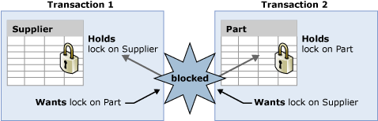
What is a deadlock?
Two or more processes are waiting for one another to obtain locked resources
Transaction 1 holds a lock on the Supplier table and requires a lock on the Part table.
Transaction 2 holds a lock on the Part table and wants a lock on the Supplier table
Both tasks cannot continue until a resource is available and the resources cannot be released until a task continues, and therefore a deadlock state exists
Notes:
Key Points:
Occurs when two or more tasks permanently block each other by having a lock on a resource that the other tasks are trying to access.
SQL Server always resolves deadlocking by choosing a victim and therefore, breaking the cycle. Most often, you can address deadlocking by using methods such as a nolock hint to address a deadlocking situation with item 2 in the list above (worker threads), you first need to understand what is being locked and in what order.
Distributed deadlocks usually occur when one of the locked resources resides outside SQL Server (or on another SQL Server).
===============
More Information
===============
What is a deadlock?
A deadlock exists when the following four conditions exist simultaneously:
No pre-emption.
Incremental allocation of resources (Locks are acquired as needed, rather than acquiring them all before beginning the transaction).
Incompatible use of resources (Here, compatibility refers to the one defined in our lock compatibility table).
Cycle When the lock monitor initiates deadlock search for a particular thread, it identifies the resource on which the thread is waiting. The lock monitor then finds the owner(s) for that particular resource and recursively continues the deadlock search for those threads until it finds a cycle. A cycle identified in this manner forms a deadlock.
Deadlocking is not specific to SQL Server or even to relational databases. Any system that must manage shared resources among multiple users, threads, or processes may be susceptible to deadlocks.
Each user session might have one or more tasks running on its behalf where each task might acquire or wait to acquire a variety of resources. The following types of resources can cause blocking that could result in a deadlock:
Locks
Worker threads
Memory
Parallel query execution-related resources
Multiple Active Result Sets (MARS) resources
To understand this better, consider the following examples:
You might address a deadlock between two tables by making sure that you access the two tables in the same order. A key-RID deadlock caused by a SELECT and UPDATE or two updates may be addressed either by converting a non-clustered index to a clustered index, where practical, or by using a lock earlier strategy in the transaction.
A deadlock can also be caused by two updates that are expensive enough that they go parallel. Therefore, you do not have a guarantee that the two rows in the same table are accessed in the same order. You may resolve such a deadlock by adding an appropriate index so that the update can be performed more efficiently, without getting a parallel execution plan.
A deadlock involving two rows on the same table with an application that uses positioned updates may be resolved by the use of an order by.
References
https://docs.microsoft.com/en-us/previous-versions/sql/sql-server-2008-r2/ms178104(v=sql.105)

Slide 66
What Is a Deadlock?
Notes:
What is a deadlock?
A deadlock exists when the following four conditions exist simultaneously:
No pre-emption
Incremental allocation of resources (Locks are acquired as needed, rather than acquiring them all before beginning the transaction)
Incompatible use of resources (Here, compatibility refers to the one defined in our lock compatibility table)
Cycle When the lock monitor initiates deadlock search for a particular thread, it identifies the resource on which the thread is waiting. The lock monitor then finds the owner(s) for that particular resource and recursively continues the deadlock search for those threads until it finds a cycle. A cycle identified in this manner forms a deadlock.
Deadlocking is not specific to SQL Server or even to relational databases. Any system that must manage shared resources among multiple users, threads, or processes may be susceptible to deadlocks.
Each user session might have one or more tasks running on its behalf where each task might acquire or wait to acquire a variety of resources. The following types of resources can cause blocking that could result in a deadlock:
Locks
Worker threads
Memory
Parallel query execution-related resources
Multiple Active Result Sets (MARS) resources
SQL Server always resolves deadlocking by choosing a victim and therefore, breaking the cycle. Most often, you can address deadlocking by using methods such as a nolock hint to address a deadlocking situation with item 2 in the list above (worker threads), you first need to understand what is being locked and in what order.
© 2016 Microsoft Corporation Microsoft Confidential 66

Slide 67
Detection and Identification
Lock monitor thread periodically perform deadlock detection in SQL Server.
Trace flags 1222,1204.
Deadlocks are captured by the system health event session.
When Deadlock occurs, SQL server returns 1205 error code to application.
Applications should use retry logic.
Check for 1205 error code to resubmit the transaction.
Notes:
Key points:
Deadlock detection is performed by a lock monitor thread that periodically initiates a search through all of the tasks in an instance of the Database Engine.
The following points describe the search process:
The default interval is 5 seconds.
If the lock monitor thread finds deadlocks, the deadlock detection interval will drop from 5 seconds to as low as 100 milliseconds depending on the frequency of deadlocks.
If the lock monitor thread stops finding deadlocks, the Database Engine increases the intervals between searches to 5 seconds.
If a deadlock has just been detected, it is assumed that the next threads that must wait for a lock are entering the deadlock cycle.
The first couple of lock waits after a deadlock has been detected will immediately trigger a deadlock search rather than wait for the next deadlock detection interval. For example, if the current interval is 5 seconds, and a deadlock was just detected, the next lock wait will kick off the deadlock detector immediately. If this lock wait is part of a deadlock, it will be detected right away rather than during next deadlock search.
Profile – Deadlock graph report
===============
More Information
===============
The Database Engine typically performs periodic deadlock detection only. Because the number of deadlocks encountered in the system is usually small, periodic deadlock detection helps to reduce the overhead of deadlock detection in the system.
When the lock monitor initiates deadlock search for a particular thread, it identifies the resource on which the thread is waiting. The lock monitor then finds the owner(s) for that particular resource and recursively continues the deadlock search for those threads until it finds a cycle. A cycle identified in this manner forms a deadlock.
After a deadlock is detected, the Database Engine ends a deadlock by choosing one of the threads as a deadlock victim. The Database Engine terminates the current batch being run for the thread, rolls back the transaction of the deadlock victim, and returns a 1205 error to the application.
Rolling back the transaction for the deadlock victim releases all locks held by the transaction. This allows the transactions of the other threads to become unblocked and continue. The 1205 deadlock victim error records information about the threads and resources involved in a deadlock in the error log.

Slide 68
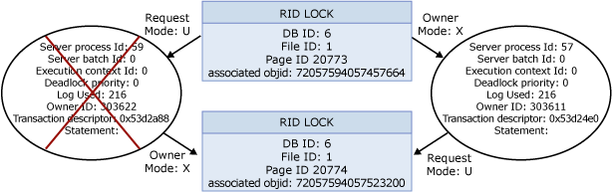
Deadlock Analysis
Using System Health Xevent
System Health Session
xml_deadlock_report
Notes:
To view deadlock information you can use system_health xevent session and Deadlock Graph tab.
Starting in Microsoft SQL Server 2008, the deadlock graph can be extracted from the system_health extended event session using the following query:
SELECT XEventData.XEvent.value('(data/value)[1]', 'varchar(max)') as DeadlockGraph
FROM
(SELECT CAST(target_data as xml) as TargetData
FROM sys.dm_xe_session_targets st
JOIN sys.dm_xe_sessions s on s.address = st.event_session_address
WHERE name = 'system_health') AS Data
CROSS APPLY TargetData.nodes ('//RingBufferTarget/event') AS XEventData
(XEvent)
WHERE XEventData.XEvent.value('@name', 'varchar(4000)') = 'xml_deadlock_report'
You can extract this data and save it as an .xdl file which can be viewed graphically in Microsoft SQL Server 2014 Management Studio. On a SQL Server 2014 instance, you can view the deadlock graph directly from SQL Server Management Studio without having to run the above query:
In the Object Explorer, go to Management > Extended Events > system_health.
Right-click package0.event_file and choose View Target Data. Scroll through the events until you find an xml_deadlock_report event.
Highlight the event and click the Deadlock tab to view the graph.
This is an event in SQL Server Profiler that presents a graphical depiction of the tasks and resources involved in a deadlock.
References:
For more information, see: Detecting and Ending Deadlocks –
https://docs.microsoft.com/en-us/previous-versions/sql/sql-server-2008-r2/ms178104(v=sql.105)
For more information, see: An XEvent a Day (13 of 31) – The system_health Session
http://www.sqlskills.com/blogs/jonathan/post/An-XEvent-a-Day-(13-of-31)-The-system_health-Session.aspx

Slide 69
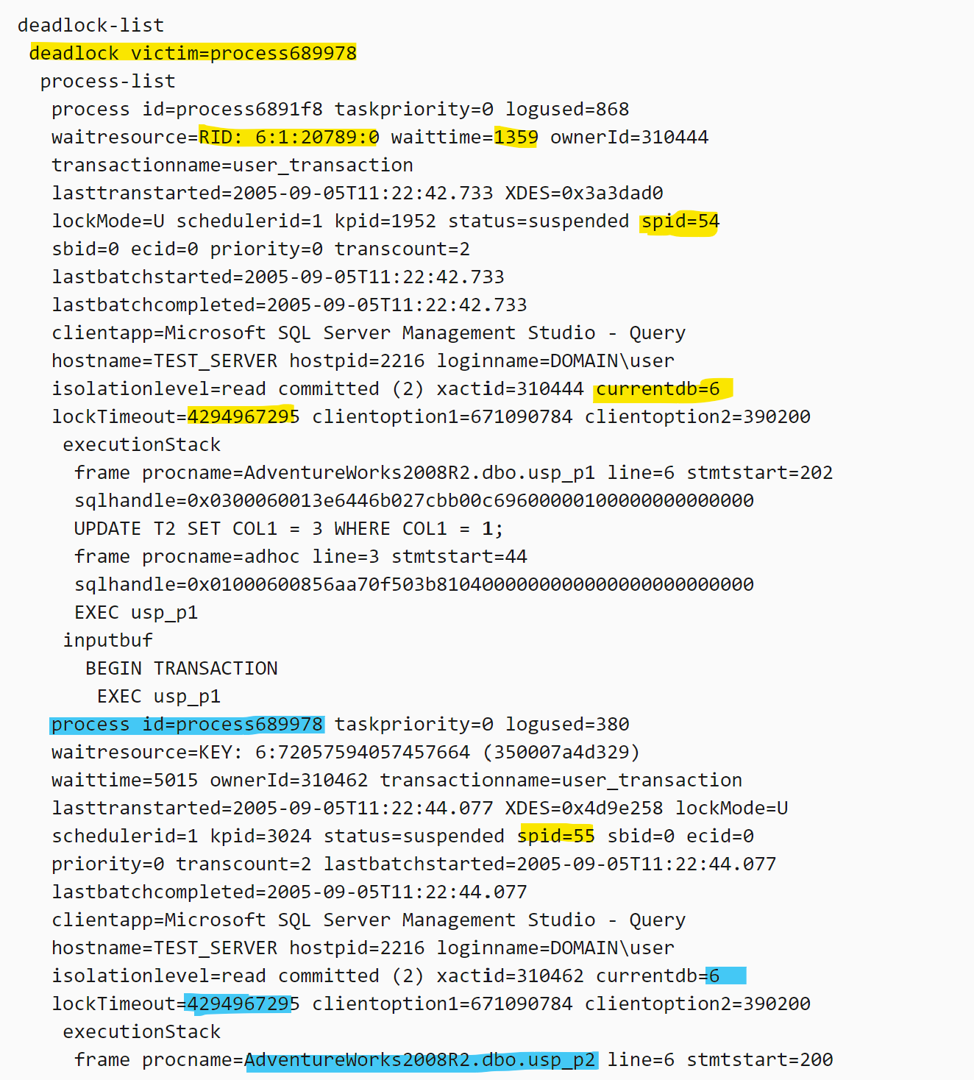
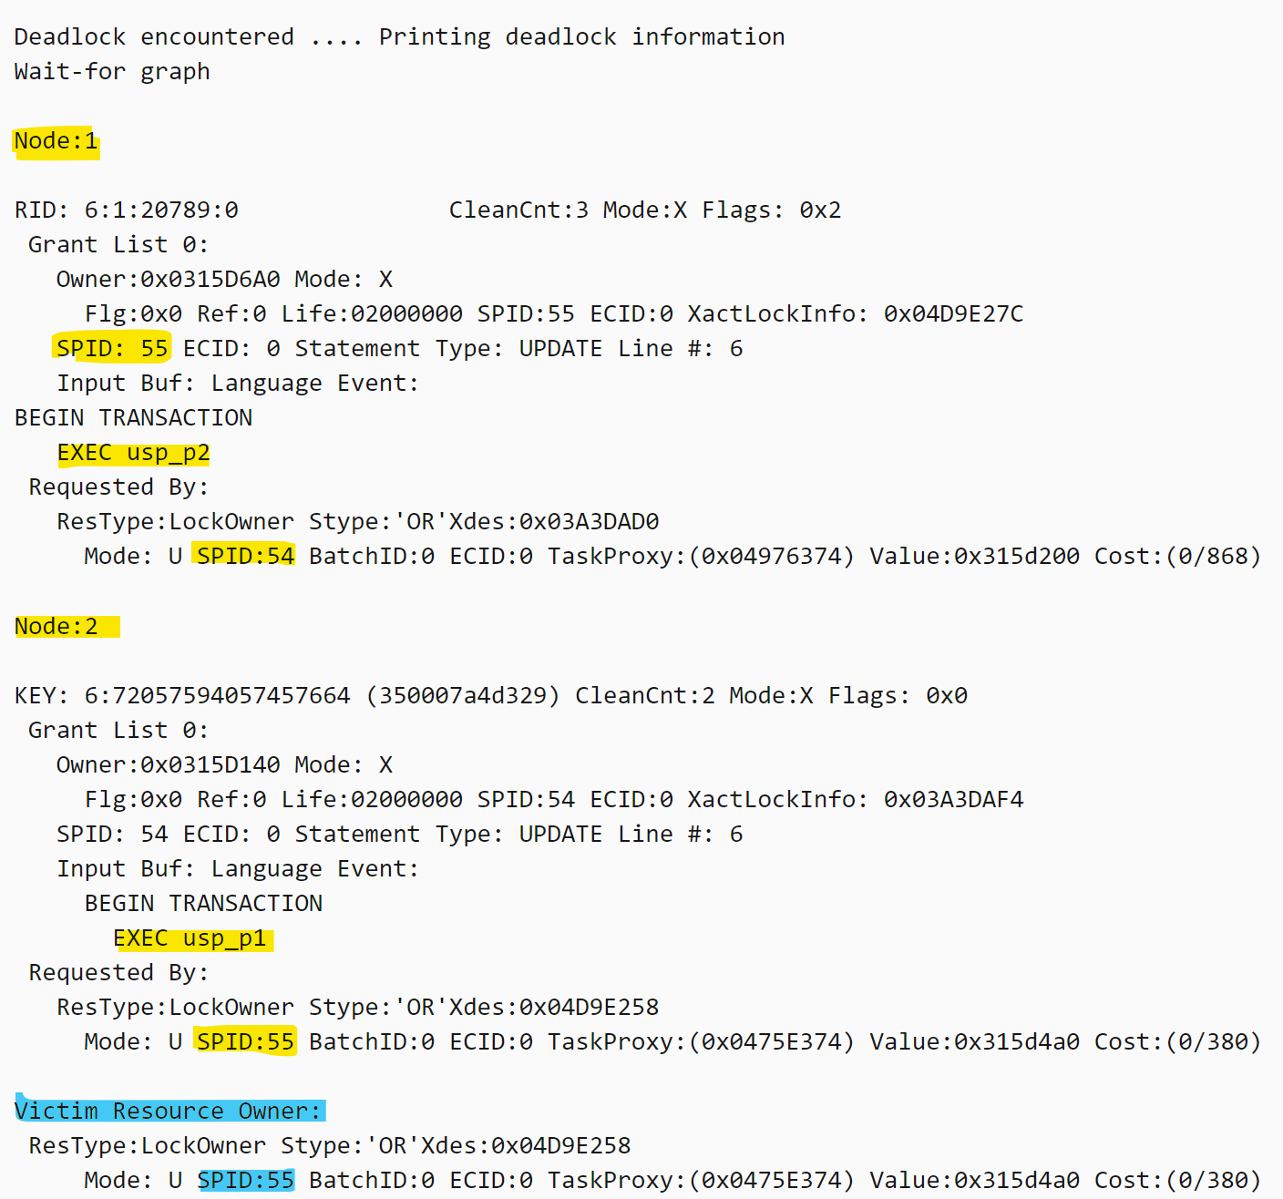
Deadlock Analysis
Using Trace Flags
Use Trace Flag 1222 or 1204 to write deadlock information in SQL Server Error log.
Trace Flag 1222 Example
Trace Flag 1204 Example
Notes:
To view deadlock information, the Database Engine provides monitoring tools in the form of trace flag 1222 deadlock information in error log
1204 disclose the information at node level.
References:
For more information, see: Detecting and Ending Deadlocks - https://docs.microsoft.com/en-us/previous-versions/sql/sql-server-2008-r2/ms178104(v=sql.105)

Slide 70
Resolution and Avoidance
SQL Server automatically selects the transaction that is the cheapest to roll back.
Use SET DEADLOCK_PRIORITY to change the likelihood of a batch being chosen as a victim.
Access the resources in the same order.
Make the transactions simple and shorten the length of the transactions.
Use error handlers to capture deadlocks.
Notes:
Key points:
Use snapshot isolation i.e. optimistic locking
Although deadlocks cannot be completely avoided, following certain coding conventions can minimize the chance of generating a deadlock. Minimizing deadlocks can increase transaction throughput and reduce system overhead because fewer transactions are:
Rolled back, undoing all the work performed by the transaction.
Resubmitted by applications because they were rolled back when deadlocked.
To help minimize deadlocks:
Access objects in the same order.
Avoid user interaction in transactions.
Keep transactions short and in one batch.
Use a lower isolation level.
Use a row versioning-based isolation level.
Set READ_COMMITTED_SNAPSHOT database option ON to enable read-committed transactions to use row versioning.
Use snapshot isolation.
Use bound connections.
===============
More Information
===============
Access Objects in the Same Order
If all concurrent transactions access objects in the same order, deadlocks are less likely to occur.
For example, if two concurrent transactions obtain a lock on the Supplier table and then on the Part table, one transaction is blocked on the Supplier table until the other transaction is completed.
After the first transaction commits or rolls back, the second continues, and a deadlock does not occur.
Using stored procedures for all data modifications can standardize the order of accessing objects.
Avoid User Interaction in Transactions
Avoid writing transactions that include user interaction, because the speed of batches running without user intervention is much faster than the speed at which a user must manually respond to queries, such as replying to a prompt for a parameter requested by an application. For example, if a transaction is waiting for user input and the user goes to lunch or even home for the weekend, the user delays the transaction from completing. This degrades system throughput because any locks held by the transaction are released only when the transaction is committed or rolled back. Even if a deadlock situation does not arise, other transactions accessing the same resources are blocked while waiting for the transaction to complete.

Slide 71
Demonstration
Deadlocks
Notes:
M04L05Demo02
Consider demoing the following: E:\Demos\M04L05Demo02
Use Convert_Deadlock_1.sql and Convert_Deadlock_2.sql to to create a deadlock and demonstrated deadlock graph using system health event.
-
##########

Slide 72
Troubleshooting Concurrency Performance
Identify blocking using DMVs.
Identify blocking using Extended Events.
Notes:
M04L05Lab01
Identifying Blocking:
Identify blocking using DMVs.
Identify blocking using Extended Events.
2. Identifying Deadlocks:
Observe the deadlock details in the SQL error log.
Analyze deadlocks from the deadlock graph extended event collected by the system_health session.
Solve common deadlock issue by adjust code logic.

Slide 73
Knowledge Check
How is a deadlock detected?
How should a deadlock be handled in an application?
What trace flags are used in a deadlock analysis?
What is the Extended Event used in a deadlock analysis?
Notes:
Q1: How is a deadlock detected?
A1: Deadlock detection is performed by a lock monitor thread that periodically initiates a search through all of the tasks in an instance of the Database Engine.
Q2: How should a deadlock be handled in an application?
A2: Because any application submitting Transact-SQL queries can be chosen as the deadlock victim, applications should have an error handler that can trap error message 1205. If an application does not trap the error, the application can proceed unaware that its transaction has been rolled back and errors can occur.
Q3: What trace flags are used in a deadlock analysis?
A3: 1204 (for Microsoft SQL Server 2000) and 1222 (for Microsoft SQL Server 2005 and later versions).
Q4: What is the Extended Event used in a deadlock analysis?
A4: xml_deadlock_report

